Slide 1




SensEdge
Sensor based Multi Activity Annotator

Slide 2

01
Objective
02
Problem Statement
Outline
03
Methodology and Overallworking
04
Screenshots
05
Demo video
06
Contribution

Slide 3
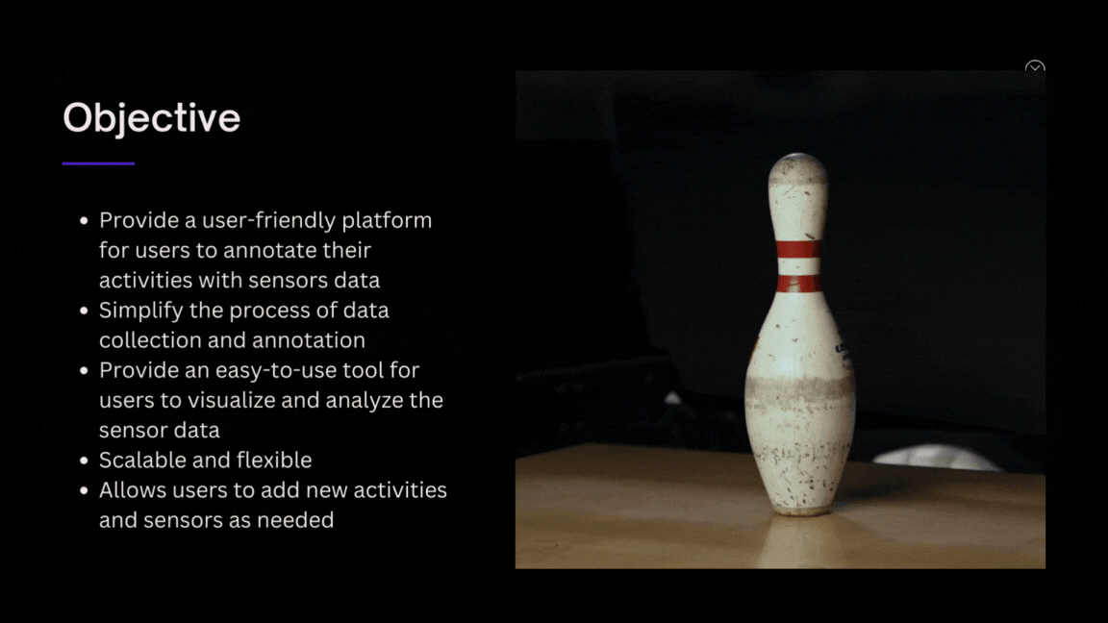

Slide 4
Approach
DATA ANNOTATION
DATA VISUALIZATION
DYNAMIC ACTIVITY SELECTION
CUSTOMIZABLE USER INTERFACE
The recorded data is annotated with the selected activity and saved in a CSV file for later analysis.
The app provides a graph visualization of the recorded data for accelerometer and gyroscope each.
Users can add as many activities as they want and select the activity they want to record data for.
The app supports Dark and Light mode feature to provide a personalized user experience.

Slide 5



Problem Statement
SensEdge is to develop a mobile application that can dynamically add and annotate multi-activity data recorded by various sensors, such as accelerometer and gyroscope. The annotated data will be stored in a CSV file that can be visualized in graphs. The application of SensEdge can be extended to various fields such as sports, healthcare, and robotics. In sports, it can be used to track the movements and physical activity of athletes for analysis and training purposes. In healthcare, it can assist in monitoring the physical activity of patients for rehabilitation and therapy. In robotics, it can aid in the development of autonomous systems that rely on sensor data for navigation and control.

Slide 6
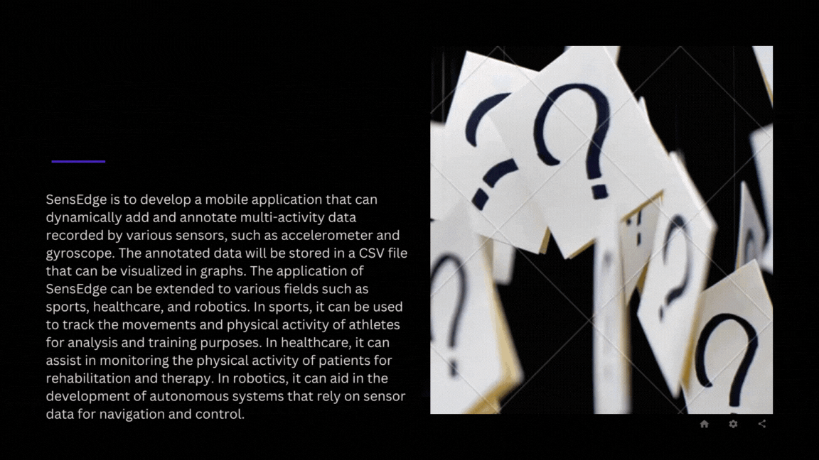

Slide 7
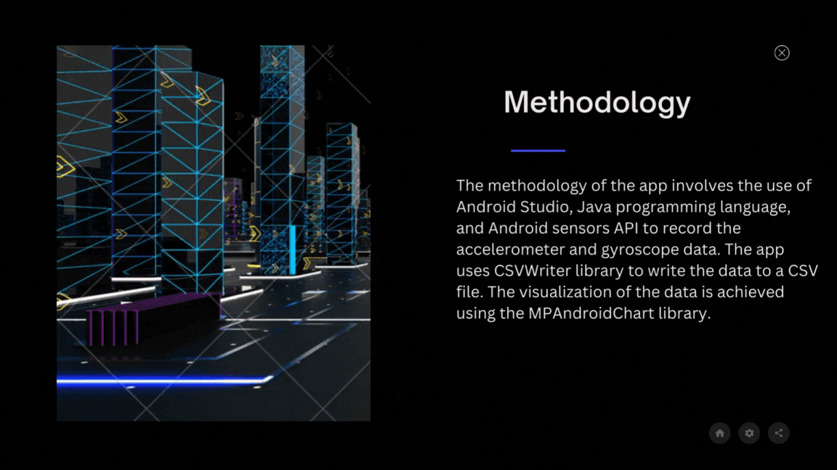

Slide 8
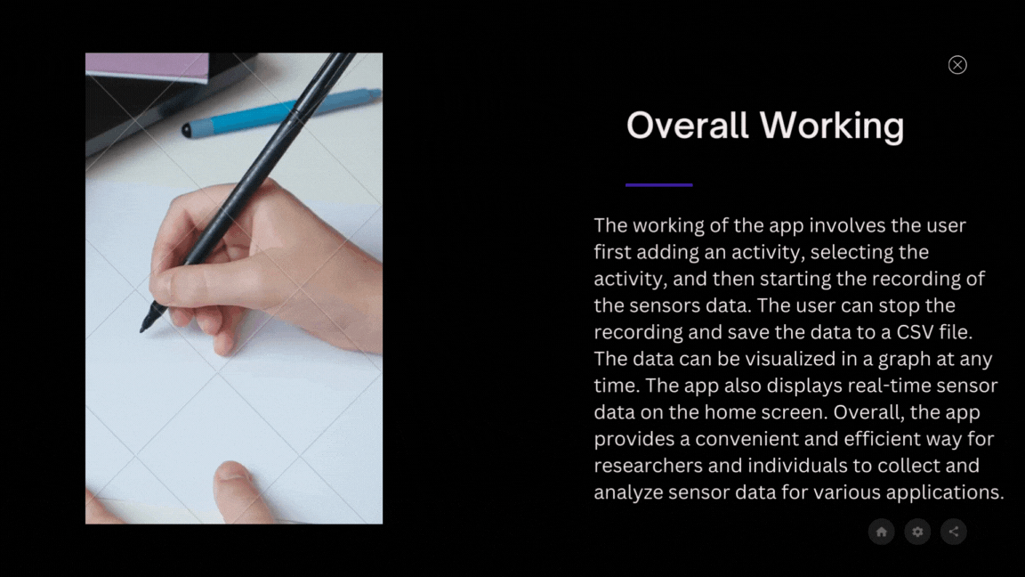
Overall Working

Slide 9
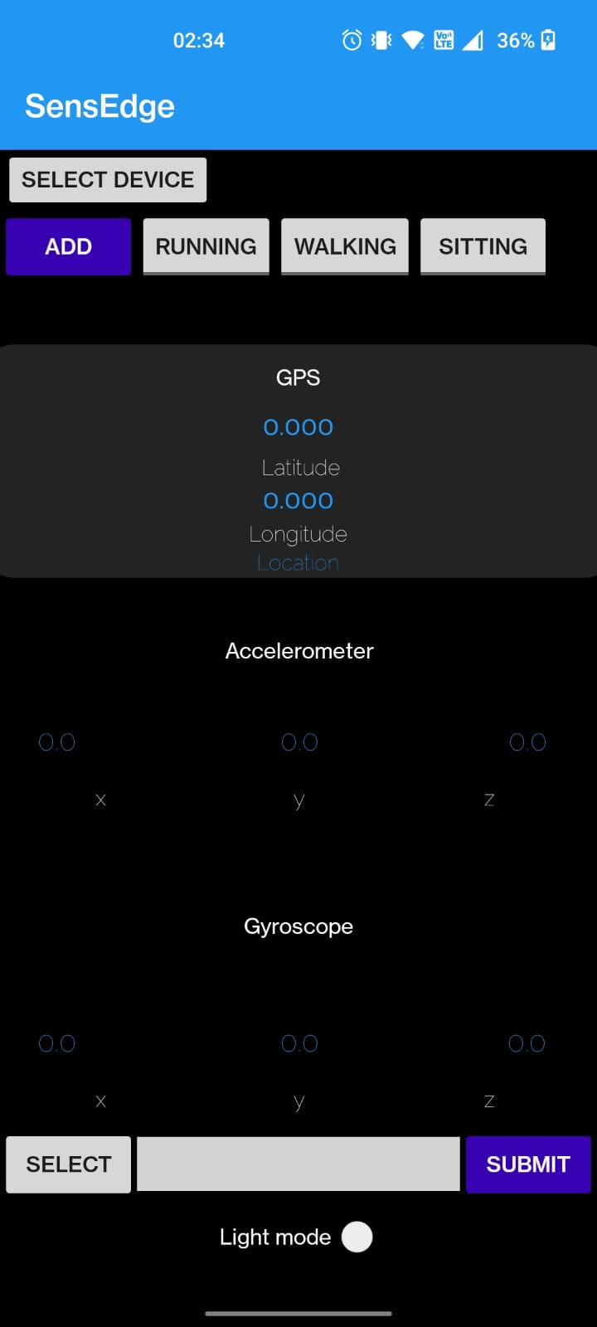
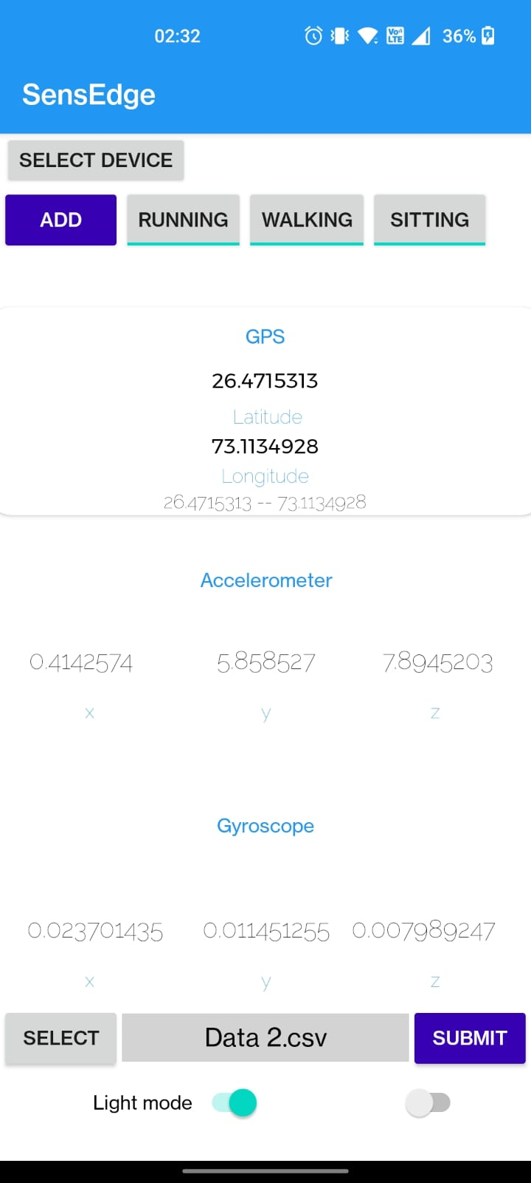
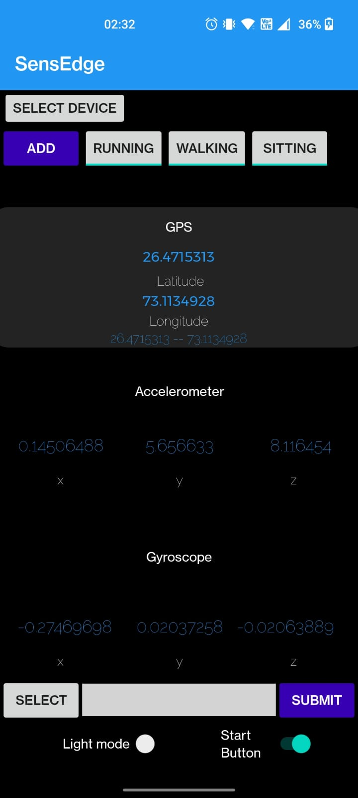
Screenshots
ADD A MAIN POINT
ADD A MAIN POINT
ADD A MAIN POINT
Briefly elaborate
on what you want
to discuss.
Briefly elaborate
on what you want
to discuss.
Briefly elaborate
on what you want
to discuss.

Slide 10
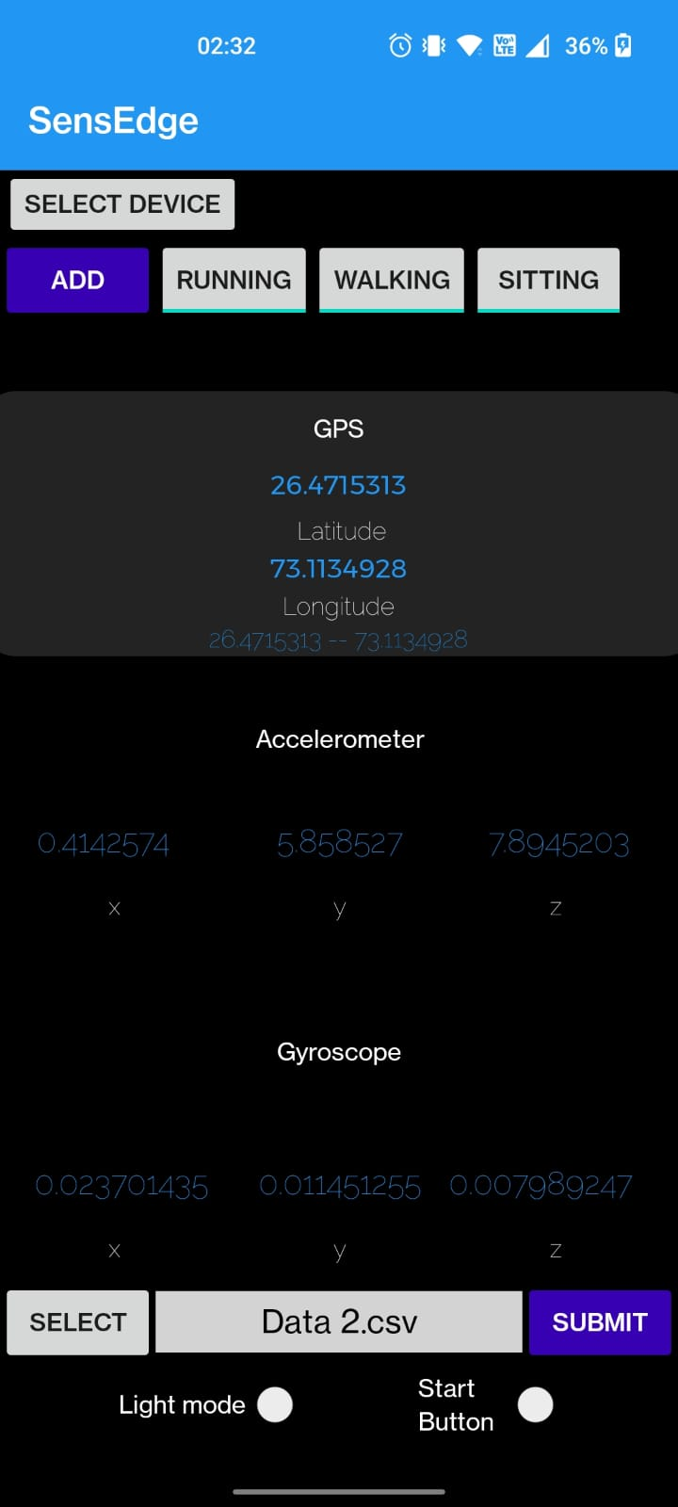
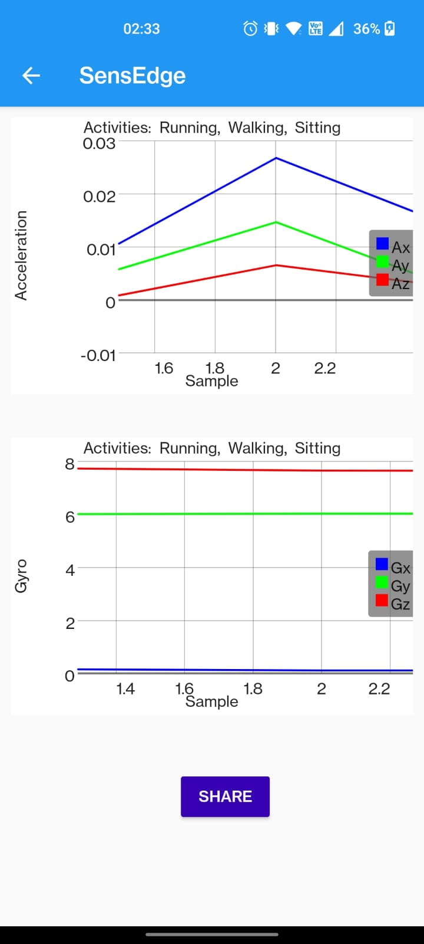


Slide 11
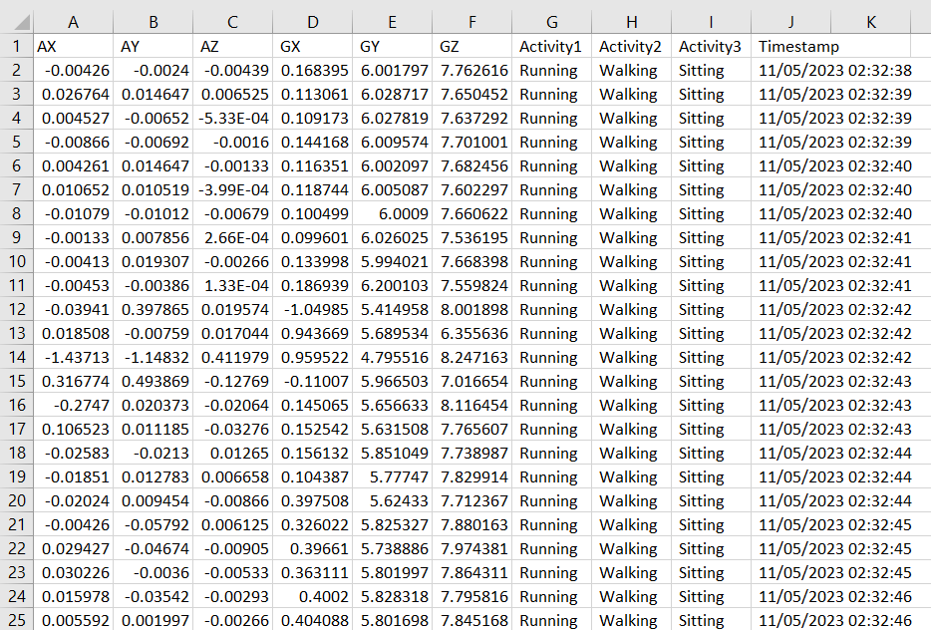
Generated CSV file

Slide 12
Contribution
Shubham
Mruganshi
Storing and Annotating the Sensor data
Fetching the CSV file for visualization
Integrating all the components for visualization
Dynamic Add Button
UI Design
Fetching the Sensor data
Visualizing the data
Logo Design
Adding share button

Slide 13
Thank you!

